Slide 1

NUTRITION ADVISOR
PRESENTED BY Anzal Hussain Anzal Zishan Sher Fatima Zahra Soha Ayub

Slide 2
AJENDA​
Problem
Statement​Problem
Solution​ Objectives​
Features Used
How Model Works
Market Place
Future Work

Slide 3
Problem Statement Topics
Increasing health issues due to poor dietary habits.
Lack of accessible and affordable personalized nutrition guidance.
Difficulty in achieving weight loss, weight gain, or muscle-building goals effectively.
Limited consideration of medical conditions in standard dietary recommendations.
Inability to adapt dietary plans based on individual progress and feedback.
Challenges in tracking and maintaining a balanced nutrient intake.

Slide 4
Problem Solution
Collect User Data
Personalized Recommendations
Dynamic Feedback
Handle Medical Constraints
Interactive Support
Privacy and Security

Slide 5
Key Features
User profile input (age, weight, height, health goals).
Data collection (diet logs, allergies, preferences).
Meal plan suggestions based on health goals (weight loss, muscle gain, etc.).
Progress tracking and updates in meal plans using ML.

Slide 6
Models to Be Used
ChatGPT (or GPT-based models for NLP tasks)
Collaborative Filtering (for recommendations)
Content-Based Recommendation Model
Classification Models (e.g., Logistic Regression, Decision Trees)
Clustering Models (e.g., K-Means, DBSCAN)
Regression Models (e.g., Linear Regression)
Ensemble Models (e.g., Random Forest, Gradient Boosting)

Slide 7
Tools to Be Used in the Project
Development Tools:
Python and JavaScrip
Database Management:
MySQL APIs and Integration Tools:
Fitbit API and Google Fit Deployment Tools:
Azure (Cloud Hosting)
UI/UX Design Tools:
Figma and Adobe XD

Slide 8
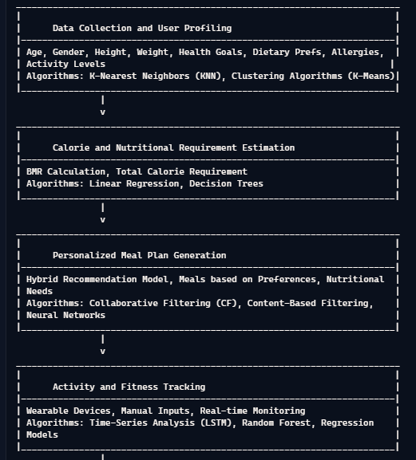
HOW THE MODEL WORKS
1

Slide 9
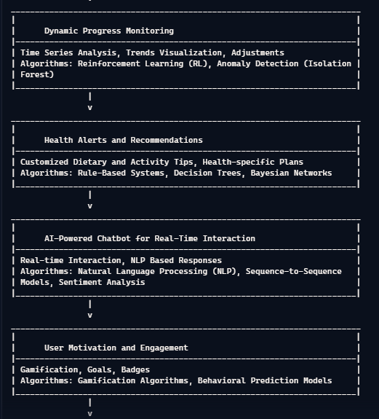
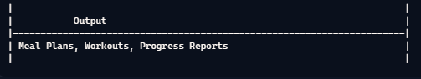
HOW THE MODEL WORKS
2

Slide 10
Datasets
Our Dataset will be combined of:
USDA Food Composition Databases
Health and Fitness Datasets
Medical and Disease Datasets
Fitness and Activity Datasets Source:
Sourcing a high-quality nutrition counseling datasetthrough Human-AI collaboration
USDA Food Composition Databases
AI nutrition recommendation using a deep generative model and ChatGPT

Slide 11
Market place
Healthcare and Wellness Market
Fitness and Sports Industry
Weight Management Programs
Dieticians and Nutritionists
Serve Beautiful life

Slide 12
Future Work
Integration with Wearable Devices
User Feedback and Continuous Learning System
Integration with Public Health and Government Programs
Multilingual and Culturally Tailored Diet Plans

Slide 13
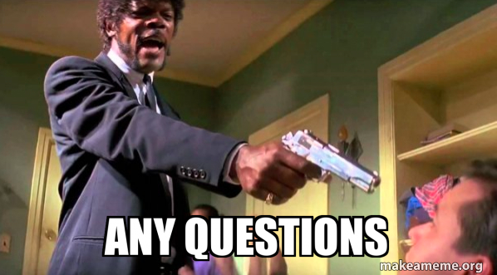
THANK YOU

